Slide 1


Exploring Textless Speech-to-Speech: From Monolingual Correction to Cross-Lingual Translation
T H E S I S P R E S E N TAT I O N
By: Ahmed Imad
Supervised By: Prof. Andreas Pester
Faculty of Informatics and Computer Science
British University in Egypt
London South Bank University
Artificial Intelligence
June 2025

Slide 2
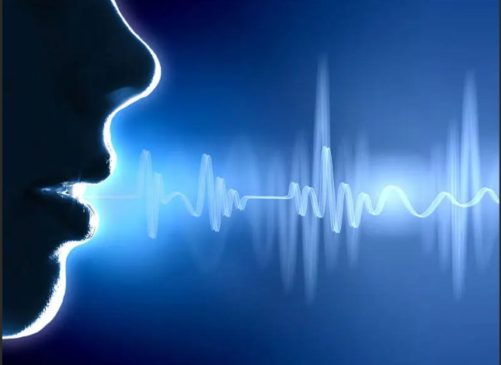

Introduction & Motivation
Traditional speech translation routes audio through text, losing emotion and introducing delays and errors.
Can we realize direct, textless speech-to-speech (S2S) with better fidelity and speed?
This project explores a direct, end-to-end pipeline for S2S, breaking new ground in monolingual speech correction and cross-lingual translation.

Slide 3
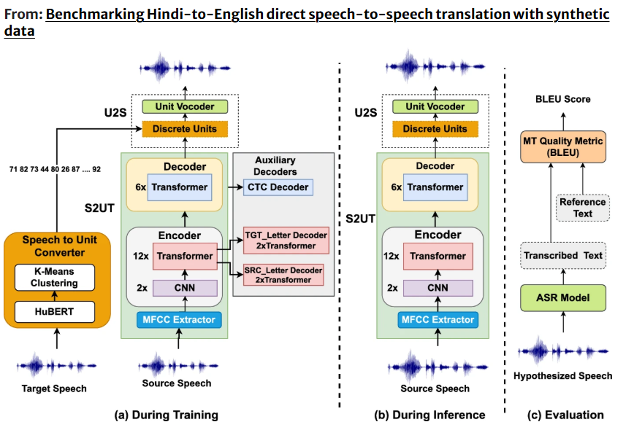
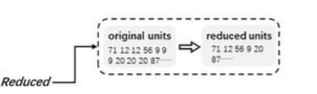
The S2UT Pipeline: Overview
Three-stage process:
Discrete acoustic unit extraction
Pre-trained HuBERT + K-Means clustering to extract 100 discrete units
1
Speech-to-Unit Translation
Fairseq Transformer encodes source speech, decodes to target unit sequences
2
Unit-to-Speech Synthesis
HiFi-GAN vocoder converts discrete units back into continuous waveform
3
S2UT Pipeline Diagram Placeholder
Insert flowchart showing the three-stage process
Key advantages:
End-to-end direct translation without text intermediaries Preserves speaker characteristics and paralinguistic features Potential for faster real-time performance

Slide 4
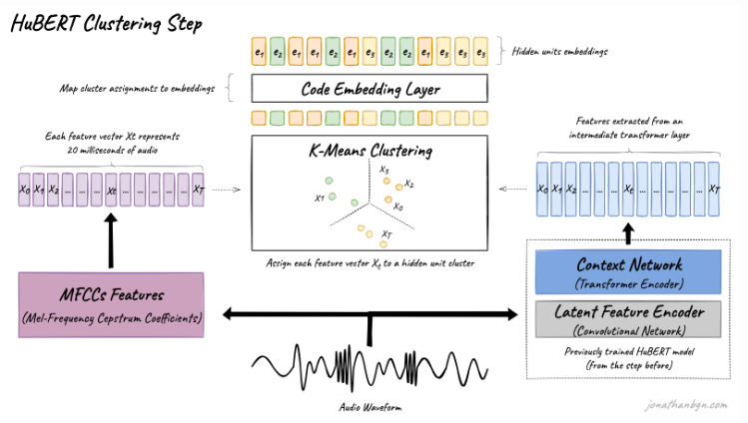
Core Technology: Discrete Unit Generation
HuBERT: Feature Extraction
Use of pre-trained HuBERT Base speech model for feature extraction
Features extracted from the 6th Transformer layer
Captures rich contextual representations of speech
Self-supervised model trained on 960 hours of unlabeled speech
K-Means: Unit Quantization
MiniBatchKMeans clustering of feature vectors
Groups similar acoustic patterns into 100 distinct units
HuBERT + K-Means Diagram
Add visualization showing speech waveform → HuBERT features → K-Means clustering → discrete units
Creates a discrete, finite vocabulary of speech sounds
Speech Input
→
HuBERT Features
→
K-Means
→
100 Units
Units are language-agnostic and approximately phoneme-level

Slide 5
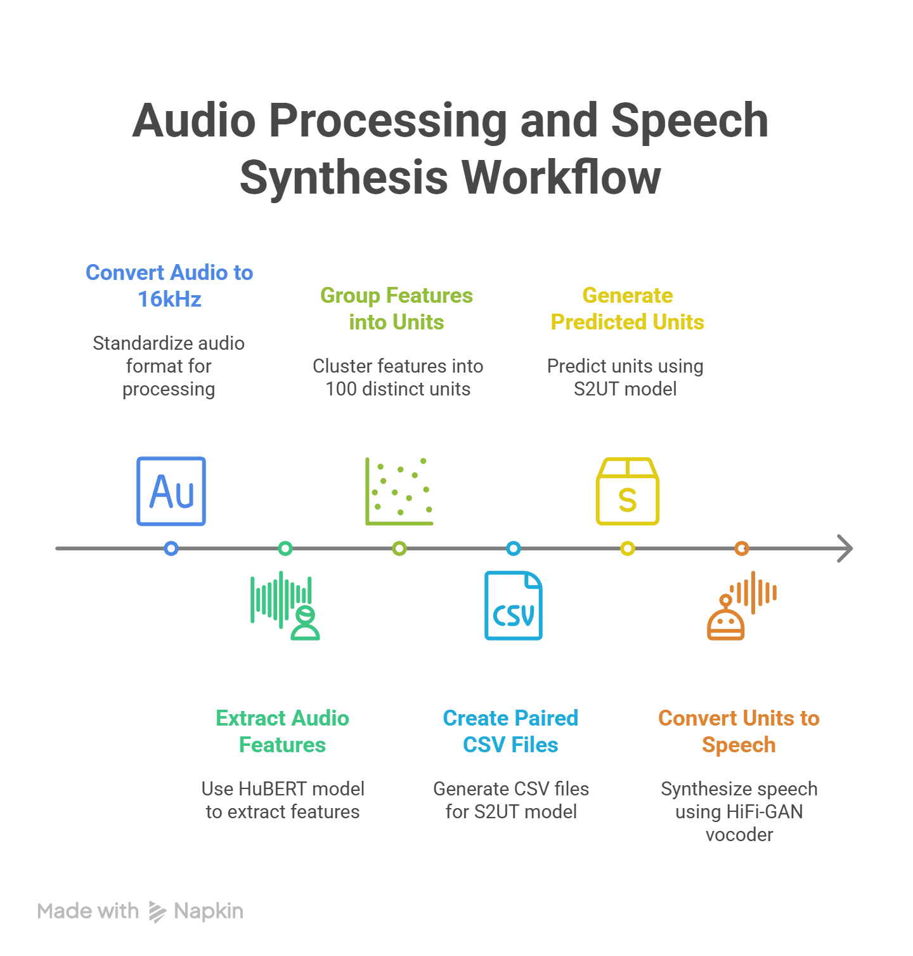
System Architecture
S2UT Model (Fairseq Transformer)
Encoder processes source speech spectrogram Decoder predicts sequence of target discrete units Implementation: s2ut_transformer_fisher from Fairseq
HiFi-GAN Vocoder
Takes predicted discrete units as input
Synthesizes high-fidelity speech waveform
Pre-trained model, fine-tuned on target language
Datasets
LJSpeech
Monolingual correction
FLEURS
Arabic-English (~2.3k)
CoVoST 2
German-English base
CVSS-C
~128k German-English pairs
Model Architecture Diagram
Speech-to-Unit Translation (S2UT) with HiFi-GAN vocoder

Slide 6


The Evaluation Challenge
How do we objectively score generated speech output?
Automatic Speech Recognition (ASR – Whisper) used to transcribe outputs for metric scoring.
Caveat: ASR introduces its own errors and formatting quirks (e.g., "nineteen sixty-three" becomes "1963").
Standard BLEU/WER can be misleading. More robust matrix like ROUGE is required for certain tasks.
Evaluation Metrics
Generated Speech Output
Raw audio output from S2UT pipeline
ASR Transcription (Whisper)
Convert audio back to text using Whisper ASR
Metric Calculation & Scoring
Compare transcription with reference text using multiple metrics
BLEU
Precision-based n-gram matching
WER
Word Error Rate
METEOR
Handles synonyms and stemming
ROUGE
Recall-oriented, better for text flow
ASR Formatting Example (Figure 15 &18 in the Thesis)
ASR Output
"nineteen sixty-three" "1963"
Different text representations of the same spoken content lead to misleading evaluation scores
Original Reference

Slide 7

Trial 1: Monolingual Grammar Correction
Approach
Novel task: No public dataset—synthetically corrupted LJSpeech units to create source-target pairs
Model successfully learned to correct grammatical errors directly in speech
ROUGE matrix proved more reliable than BLEU for this task type
Performance Results
Before Normalization
After Normalization
From To Source Incorrect Corrected
Key Metrics
WER
17.99%
After normalization
ROUGE-L
85.10
More reliable for this task
Metric | Raw | Normalized | Improvement
WER (%) | 24.45 | 17.99 | ↓ -6.46
BLEU
73.83
After normalization
METEOR
84.4
High quality score
BLEU | 67.86 | 73.83 | ↑ +5.79
ROUGE-L | 85.09 | 85.10 | ↑ +0.01
METEOR | 78.85 | 84.4 | ↑ +5.55

Slide 8
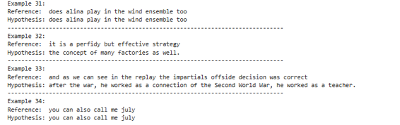
Trials 2 & 3: Cross-Lingual Translation
Key Findings
Data scale is critical for S2ST quality and performance
Low-resource experiment produced noisy, often incorrect speech translations
High-resource model achieved significantly better fluency and translation quality
German to English ASR Inference (Figure 32 in Thesis)
Bar Chart: 2.3k vs 128k samples
(Insert dataset size comparison here)
Dataset Comparison
LOW-RESOURCE
Arabic → English
Dataset: Sample size: Result:
 | Source German | Target English
FLEURS
~2,300 pairs Noisy output
HIGH-RESOURCE
German → English
Dataset: Sample size: Result:
CVSS-C
~128,000 pairs Fluent translation
The 55x increase in training data resulted in substantial performance gains across all metrics, confirming the critical importance of data scale for Speech-to-Speech Translation.

Slide 9
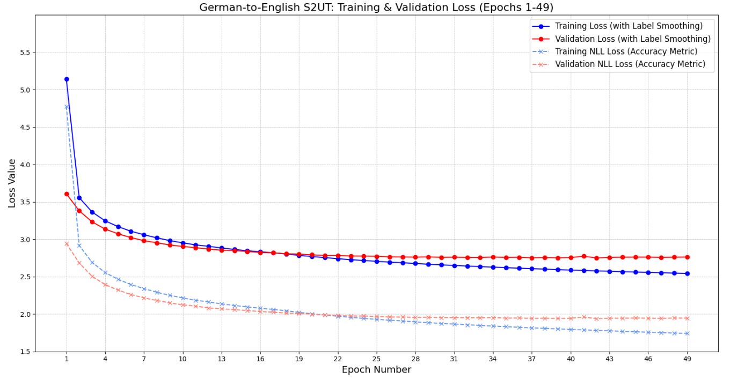

Results: German-to-English S2ST
Performance Metrics
German-to-English Training Loss
BLEU
28.21
Normalized
WER
52.07%
Normalized
METEOR
4.39
Normalized
Metric | Raw | Normalized
BLEU | 19.75 | 28.21
chrF | 32.3 | 40.55
TER | 57.85 | 50.06
WER (%) | 65.62 | 52.07
ROUGE-L | 37.01 | 48.87
Loss Curve Placeholder
(Insert German-to-English Loss Curve here)
Results Summary
After normalization, our German-to-English S2ST system achieved a competitive BLEU score of 28.21 on the CVSS-C dataset.
METEOR
32.15
43.39
Key Findings
WER of 52.07%, listening tests confirmed the audio output was clear but sometimes gives wrong translation due to the task complexity.
Clear, fluent speech output with natural-sounding prosody
High-resource training data (128k pairs) proven critical for performance
The high METEOR score (43.39) indicates good semantic alignment between reference and generated translations.
Normalized scores consistently higher, demonstrating the importance of ASR normalization in evaluation
Training converged effectively, with validation loss stabilizing after approximately 50 epochs.

Slide 10
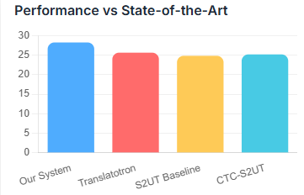
Comparison with State-of-the-Art
BLEU Score Comparison
(German-English Translation)
Model
BLEU Score
Dataset
Difference
OURS
S2UT (This work)
28.21
CVSS-C (German-English)
—
SOTA
Translatotron
25.60
Fisher (Spanish-English)
+2.61
S2UT
24.80
CVSS-C (French-English)
+3.41
Chart Placeholder
Bar chart comparing BLEU scores across models
CTC-S2UT
25.16
CVSS-C (French-English)
+3.05
Additional Metrics (Our Model)
ROUGE-L
48.87
METEOR
43.39
Key Findings
Our model's normalized BLEU score of 28.21 is highly competitive in the field Surpasses the foundational Translatotron model by +2.61 BLEU points
Outperforms both baseline S2UT and CTC-S2UT models on the same CVSS-C dataset
Validates our pipeline as a successful, state-of-the-art system
WER
52.07%
chrF
40.55

Slide 11

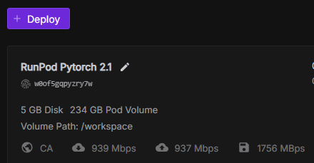




Project Costs & Resources
Hardware
GPU & Storage Resources
Cost Allocation
Percentage of total project budget
RunPod Instance VRAM
Persistent Storage
2x A100 GPU
80GB
240GB
Pie Chart Placeholder
Cost distribution visualization
Datasets
Speech Corpora & Processing
LJSpeech
FLEURS Arabic-English CVSS-C German-English
~ 24 hours
~ 2.3K samples
Resource | Unit Cost | Quantity | Total Cost
A100 GPU (RunPod) | $2.38/hour | 90 hours | $214.2
Persistent Storage | $0.007/GB/Day | 234 GB | $196.56 (120 Days)
~ 128K samples
Compute Time
Training & Inference Hours
Total Project Cost |  | $410.76
HuBERT Feature Extraction S2UT Model Training Evaluation & Testing
~ 6 hours
~ 72 hours
~ 12 hours
GPU compute represents the largest expense, highlighting the intensive computational requirements of Speech-to-Speech Translation research.

Slide 12

Future Work
Explore State-Space Models (like JEN-1) and unified audio-text models (Llama Omni) for improved performance and lower computational cost
Target Conferences like ICASSP, Interspeech, or IEEE SLT
Scaling up the grammar correction with emotional data
Develop non-ASR-based evaluation metrics like MOS or BLASER 2.0 for direct speech-to-speech quality assessment
Advanced Architectures
State-Space Models (JEN-1) offer linear scaling with sequence length, potentially reducing the computational cost while maintaining high performance. Unified models like Llama Omni could bridge text and audio domains.
Expressiveness
Voice conversion and style transfer modules would preserve speaker identity and emotional qualities from source to target speech, creating more natural and personalized translations.
Data Efficiency Improvements
Synthetic data augmentation
Better Evaluation
Semi-supervised learning
Moving towards direct, textless evaluation metrics like BLASER 2.0, as well as the human evaluation metrics like MOS would eliminate ASR- related errors in evaluation.
Improved pre-training
Few-shot adaptation
Scaling Beyond SOTA
Integrating diffusion models like Dub-S2ST could improve speech quality while new pretraining techniques could further enhance low-resource performance, pushing beyond current state-of-the-art results.

Slide 13




Conclusion & Key Contributions
Successfully implemented and validated a complete end-to-end textless S2UT pipeline across multiple tasks.
Pioneered the application of S2UT for monolingual grammar correction using a novel synthetic data generation approach.
Provided clear, quantitative evidence of the critical dependency of S2ST performance on data scale through comparative experiments.
Outperformed several published S2ST baselines on German–English translation with a normalized BLEU score of 28.21.
Research Achievements
Complete S2UT Pipeline
Successfully integrated HuBERT unit extraction, Transformer-based translation, and HiFi-GAN vocoding
Novel Application Domain
First application of S2UT for monolingual grammar correction with ROUGE-L of 85.10
Key Insight
The research demonstrates that textless S2S approaches are viable and competitive, but their performance is heavily dependent on the scale and quality of training data.
Data Scale Analysis
Demonstrated 55x increase in training data yields substantial performance gains across all metrics
SOTA Performance
This BLEU score is clearly superior to ground-up work for future research (28.2), beating baselines like S2UT (24.8), Speech-to-Text-to-Speech (25.6), and CTC-based S2UT systems (25.1), making these models more accessible and practical for real-world applications.

Slide 14
Thank You
Questions?
Exploring Textless Speech-to-Speech Translation | June 2025

